Slide 1


Integration Operations The Key to Success for Integrations
Moderne IT-Integrationen – 30 november 2022
Lucas Jellema, CTO & Architect AMIS | Conclusion

Slide 2
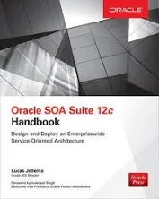
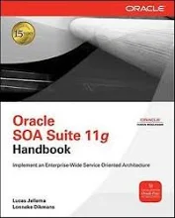





Architect on many integration initiatives with dozens of large and small organizations in The Netherlands
Oracle ACE Director, Java Rockstar, author of two books on integration
frequent speaker on conferences & active blogger
Lucas Jellema
Cloud Solution Architect & CTO
lucas.jellema@amis.nl | technology.amis.nl | @lucasjellema | lucas-jellema

Slide 3


Notes:
angry suppliers
their bills have not been paid. Why Not?
They have been approved (in the invoice management app) - but not forwarded to the financial system where payment is done

Slide 4

daily approved invoices batch
record, approve/deny
invoices
€
Basware
MS Business Central - Finance
€
€
integration
€
Invoices did not get paid when the integration job had not been executed
and no one had noticed
At a later moment in time – more invoices were not paid even though the integration job had run just fine and no errors were reported
the daily batch file was empty – and no controls checked for anomalies (extremely low numbers of invoices) or discrepancies between Basware and Business Central)
Later still, some invoices were paid multiple times
The integration was re-executed after it failed to write some logging – and no deduplication was implemented

Slide 5



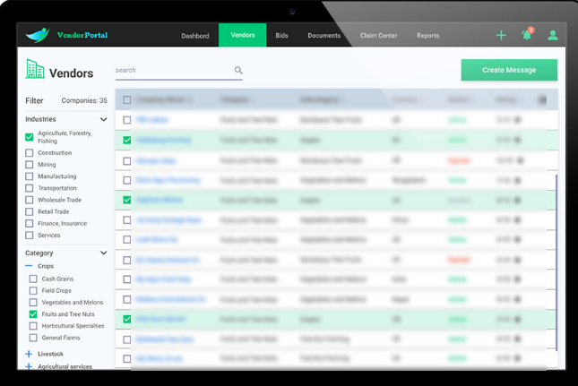
Notes:
the web portal was never the fastest application in the world but usually performed at a stable if barely acceptable level
several times during the month its performance collapsed and it became unusable. 20-30 seconds wait times and time outs.
it was unclear why that happened – at those specific moments

Slide 6

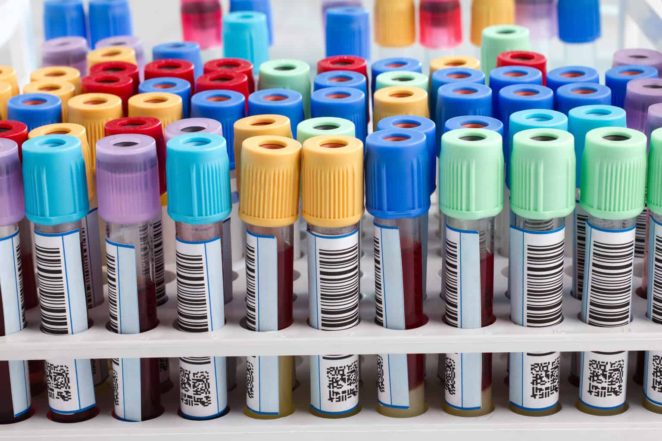


lab results
Web Portal
Service Bus
Enterprise Database
When the lab results batch was started (every two weeks or so) …
… the Service Bus assigned almost all its resources to processing them
… leaving precious little capacity for the requests from the Portal
No one knew when these batches were scheduled
and no one had thought to either scale or prioritize resource assignment
for a long time: no one understood the performance degradation

Slide 7

Notes:
long queues at peak times such as easter, christmas and public holidays
completing the purchase at the cash register was extremely slow – especially for customers with a loyalty card; during the day, the process slowed down even further

Slide 8




Shop
Shop
Shop
Shop
Shop
Shop
Loyalty Card Service
Shop
Shop
Shop
VM
As the number of cash register transactions grows, the Loyalty Card Service gets swamped and response times increase
the application cannot scale up (VM is using all available resources)
the application cannot scale out (no load balancer | it has not been designed for concurrency)
Other services deteriorate as well – running in the same VM
The problem is detected early on (and the shops furiously keep contacting the support desk)
… support staff does not know what to do (no training or instructions for this situation)

Slide 9
Common thread
Requirements
Development
Build, Test, Q&A
Release & Deploy

Slide 10
Common thread
Requirements
Operations
Development
Build, Test, Q&A
Release & Deploy

Slide 11

Shift Left
Requirements
Operations
Development
Build, Test, Q&A
Release & Deploy
Ops by Design

Slide 12



Ops thinking in Design and Dev & Test
Out-of-the-Box Azure Connector “New Records in Salesforce collection”
poll every X minutes (to find records created since its previous run)
trigger New Contacts Processor to process new records
What if …
.. oops. Connector’s memory does not survive restarts: after rolling out new version or a restart for some other reason, the connector cannot recognize new records
as a result – some new records will not be processed
Conclusion: connector cannot be used (without flanking mechanisms)
Salesforce
New Contacts Poller
New Contacts Processor
Notes:
https://learn.microsoft.com/en-us/azure/connectors/connectors-create-api-salesforce

Slide 13
Integration Operations Objectives
World Peace
Deutschland Weltmeister Fussball
Corporate Profit
Data from A => B
Integrations running according to SLA
IT costs allocated to business based on usage
KPIs in green
Extensive Monitoring
Logs and Metrics collection

Slide 14
Integration Operations Objectives
World Peace
Deutschland Weltmeister Fussball
Corporate Profit
Data from A => B
Integrations running according to SLA
IT costs allocated to business based on usage
KPIs in green
Extensive Monitoring
Logs and Metrics collection

Slide 15
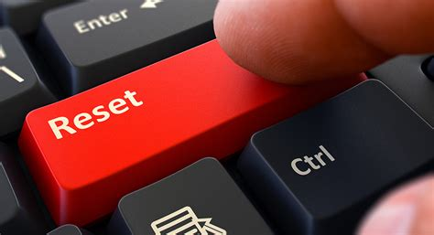
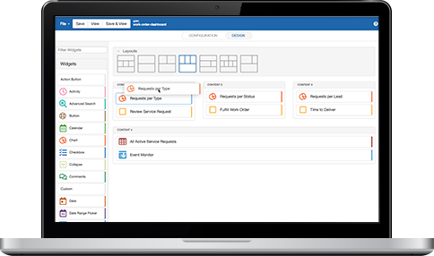

Required for successful operations
Definition of what is success
What should be achieved by each data flow (functionally)
how can success be verified?
how to act in case of non-happy flows?
What are non-functional constraints and conditions?
Security, availability, performance, costs, CO2
KPIs and targets?
Whenever the monitoring indicated that a service was down – the entire portal was stopped and restarted
One particularly unstable service determined whether today was the user’s birthday. It triggered multiple restarts per day …

Slide 16
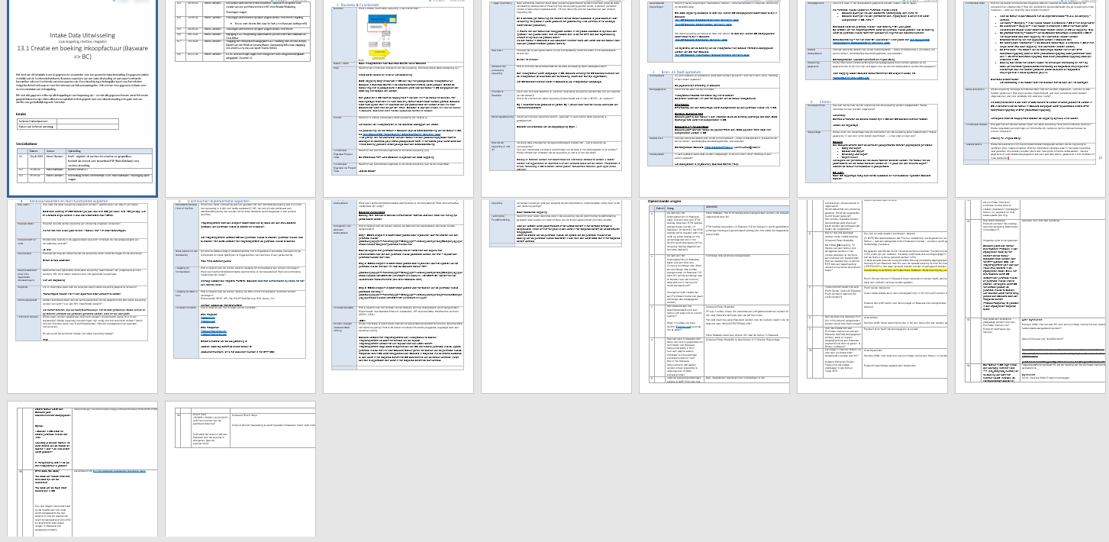


Data Exchange “Fingerprint”
Foundation for Solution Design and Test plan, basis for Operational mechanisms & processes
Describe for each Data Exchange:
business value and owner/stakeholders
priority / criticality
business process
trigger (when/why)
result (& verification)
source and destination systems
data structures & filtering | mapping
non happy flows
quality controls
security
operational targets

Slide 17
Dev => Ops
Certificate, credential, user, endpoints; Backup, Archive, Purge, Patching, Cost Allocation Support Desk
Dev
Deploy / Rollout / Activate
Intake / Ops Acceptance
Improve instrumentation, scalability, recovery, non happy flow handling, configurability
Observe
Interpret
Act
Learn & Improve
Routine Management
Fire drills / Chao(p)s Testing
Recovery, Fail Over, Hot Fix, Rollback of Rollout, Scale Out, …
Report & Improve

Slide 18
Intake: Check on Operability of Integration
Dev
Intake / Ops Acceptance
Fingerprint, Specifications Functional & Non Functional, Definition of Success
Tested, QA confirmed, Cost controlled, Security inside S-BOM, Approved Technology Stack, No known vulnerabilities
Operability of Integration
Configurable
Instrumented – produces telemetry
what is needed in the form that is suitable – and not far too much!
Scalable
Stateless (or well defined state store)
Health checks
Instructions for routine activities (backup, rotation, archiving, pruning)
Instructions for non-happy situations
Facilities to carry out instructions
high degree of automation

Slide 19
Shift Left – Operations & Development without hand-over
DevOps
Application Development
Platform & Infra Operations

Slide 20
Shift Left – Operations and Development without hand-over
DevOps
Application Development
Application Operations
Platform & Infra Development
Platform & Infra Operations

Slide 21
Shift Left – Operations and Development without hand-over
Development
Operations
DevOps
Application
Platform & Infra

Slide 22
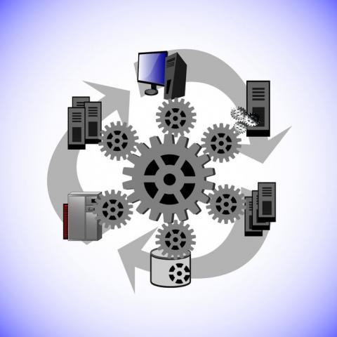
Ops Acceptance Test – confirm that operations can be done
Simulate realistic production runtime scenarios
Does the Ops play out as intended?
Areas of interest:
detection | analysis | instruction | facilities | action | result
Common scenarios:
Loss of network
Crash of server (container) (mid-job)
Peak traffic load
Incorrect message payload
Inaccessible endpoint
Invalid credentials
Power failure (forced restart)

Slide 23

Automation
Facilitate team members
Reduce risk through frequent and small steps
Increase productivity of (scarce) resources
Reduce errors, increase quality
Increase speed of process step execution
Increase reaction speed (quicker value)
Make things actually happen
Scale up
Reduce costs
Secure: run from the inside – system account (no human privileges)
source: https://enterprisersproject.com/article/2021/1/automation-4-trends-2021
vulnerability scan
deployment
end to end testing
software build
technical upgrades
unit testing
code analysis (QA)
health check
provisioning of platform and infrastructure
regression testing

Slide 24
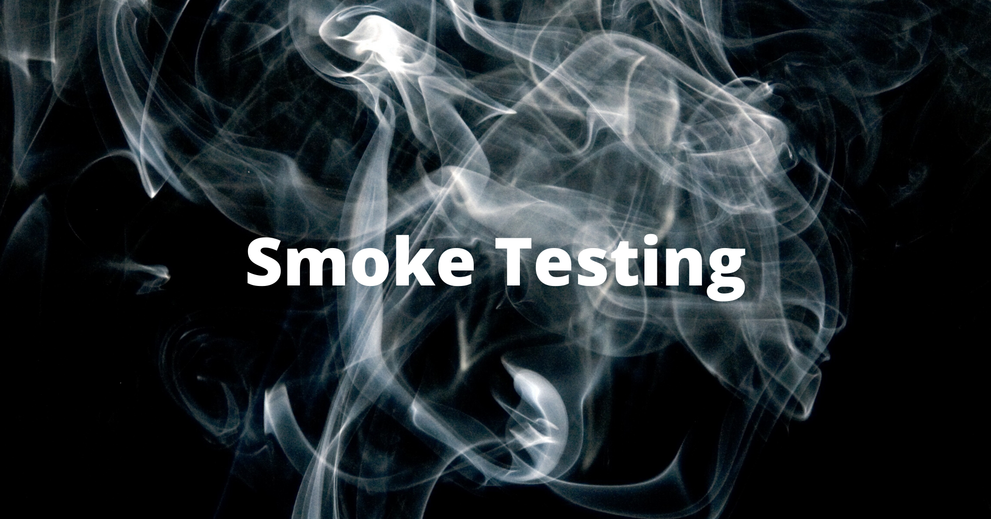

Deployment | Roll Out | Activation
Dev
Deploy / Rollout / Activate
Intake / Ops Acceptance
Automated
no hands touch production
no human privileges required
start at any moment by anyone (with permission, without expertise)
proven in Acceptance
Configurable environment specific dependencies
apply at deployment time from configuration data store
Verifiable through post-rollout Smoke Tests
Scenario to Rollback
Note: Infra == Code

Slide 25




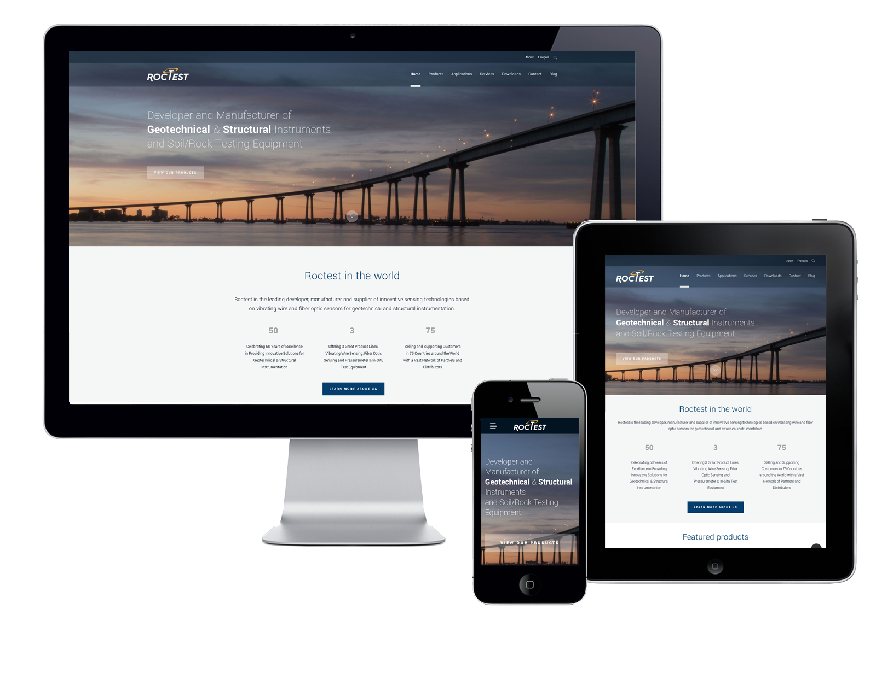
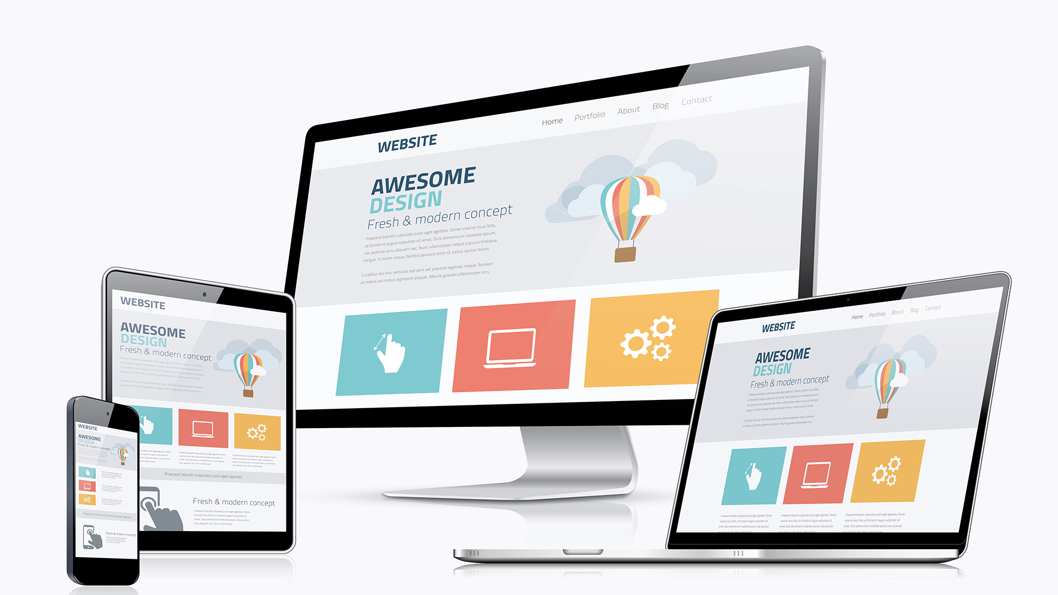
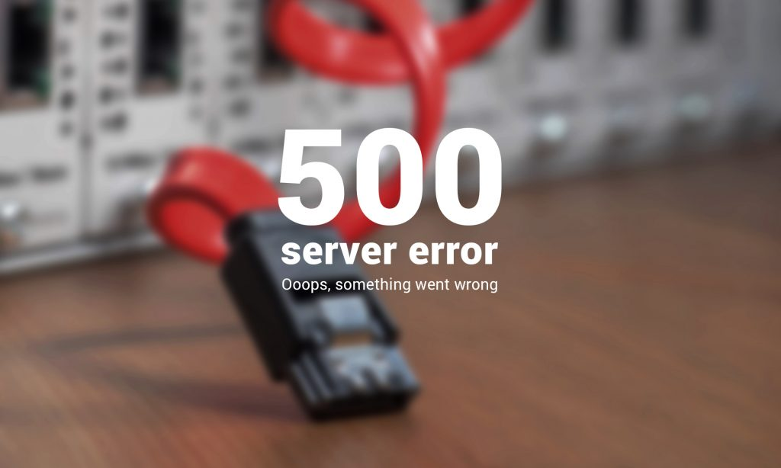


API

Slide 26
API
Catalog Service
Products Service
The endpoint address for the Products Service had been changed
… this change had not been communicated | noticed | applied
… when the change became apparent – the code for the Products Service had to be changed > built > tested > packaged > released & deployed
The certificate used by the Catalog Service had expired and requests were not accepted
… the expiration data had come and gone unnoticed
… a new certificate had to be acquired and installed
The loss of service was experienced on Monday morning. The endpoint change had been made | the certificate expired on the Saturday night before (& went unnoticed)
monitoring only detected the failed requests (HTTP 500 internal server error) on Monday
no endpoint health checks , no periodic end-to-end production tests

Slide 27

Beyond Smoke Test: Health Checks & In-Production Testing
Periodically check availability of endpoints
the ones we expose
the ones we rely on
Ideally all APIs / Services have a NOOP (ping) operation to invoke
Going further: dummy business objects that can be used in “business side-effect free” (but otherwise very real) integration execution
to verify correct functioning
even in the absence of real transactions
such as Saturday Midnight – Monday Morning
No side effect – test all the way accessibility
API
ping
API
API
validate
create
Process business objects that are known to be dummies – not sent to external systems

Slide 28
Instrument & Emit - Observe – Interpret - Act
Integrations and Platform must emit Telemetry that must be collected
Telemetry must be observed, correlated and interpreted
Insights & Alerts are translated into action
Actions are executed using means and instructions
Results are evaluated
integration
Visualize
integration
Collect
process
& interpret
Act
telemetry
Alert
Platform & Infra
Report
Analyze

Slide 29


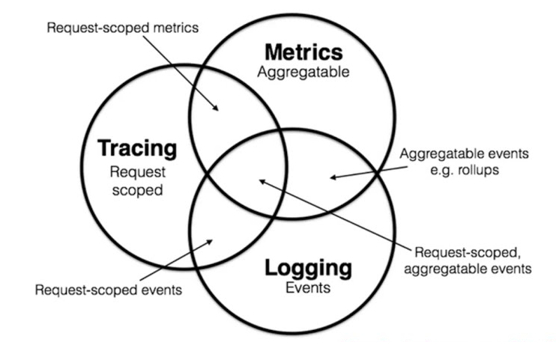
Telemetry – M(E)LT
The need to know
what has happened – when, where, what, why, who, how long
what was the status – at many moment in time
Dimensions
real time (for instant reaction or prediction & pro action) and after-the-fact for analysis
fine grained (for RCA and exception investigation) and coarse grained for aggregates, trends & patterns
business & functional, security, cost, CO2 and technical
Type of Telemetry: MELT
Tracing
Logs
Metrics
Events

Slide 30
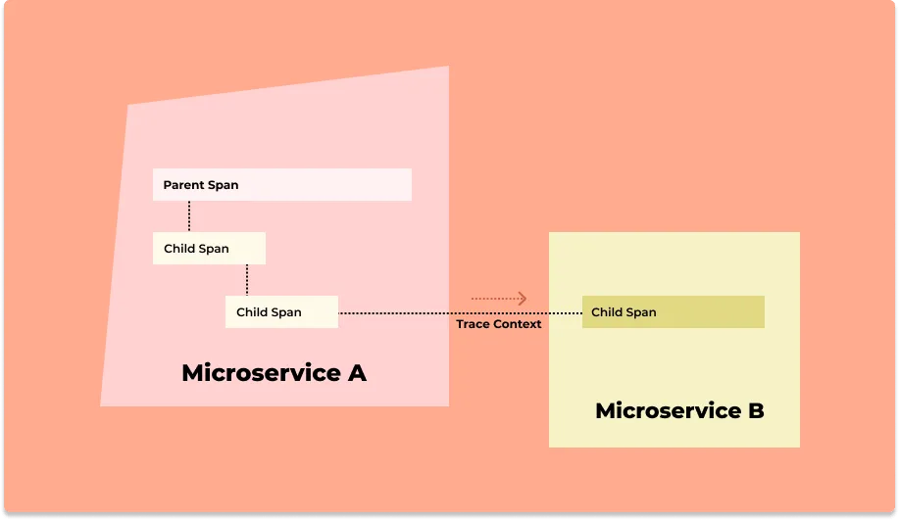
Tracing – end-to-end, cross hop visibility per request | transaction | process instance
Web Application
trace id, resource, begin & end timestamp, context, status
3rd party API
Trace
Parent Span
API Gateway
Trace Context
Child Span
Trace Context
Trace Context
API Gateway
Trace Context
Child Span
Child Span
Database

Slide 31
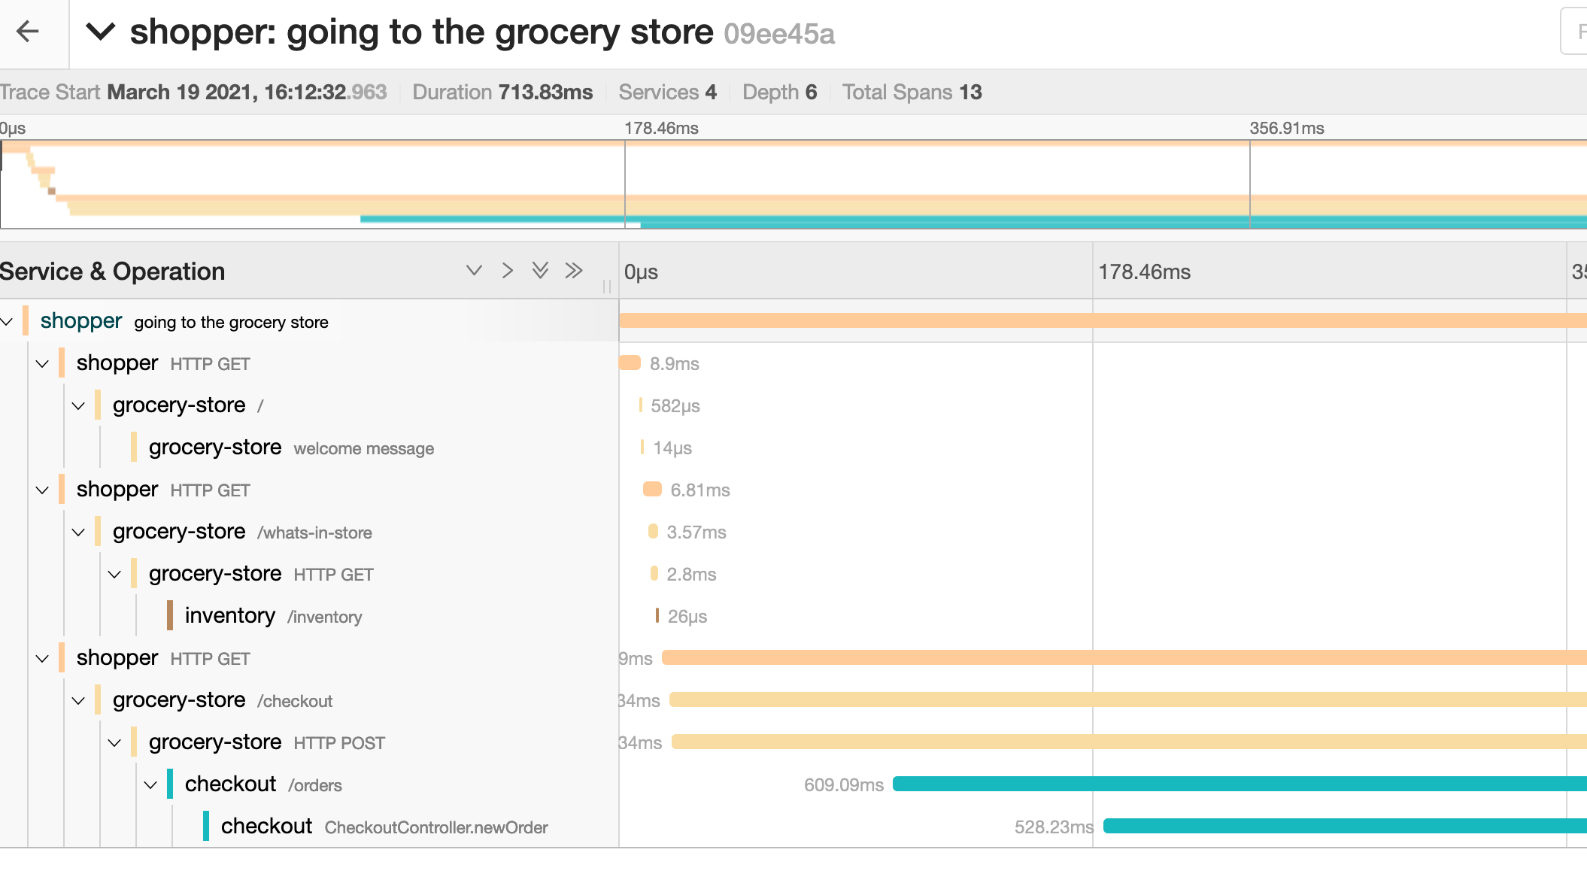
Tracing provides insight: when, where, what, why, who, how long
Trace context:
origin, source system, user attributes
request headers
Timestamp (start and end)
Component
Conversation | request | transaction
Associated logs
Status
Powerful aggregation across traces
group by component, status, origin, trace context attributes
Notes:
https://opentelemetry.io/docs/concepts/signals/traces/#span-links

Slide 32
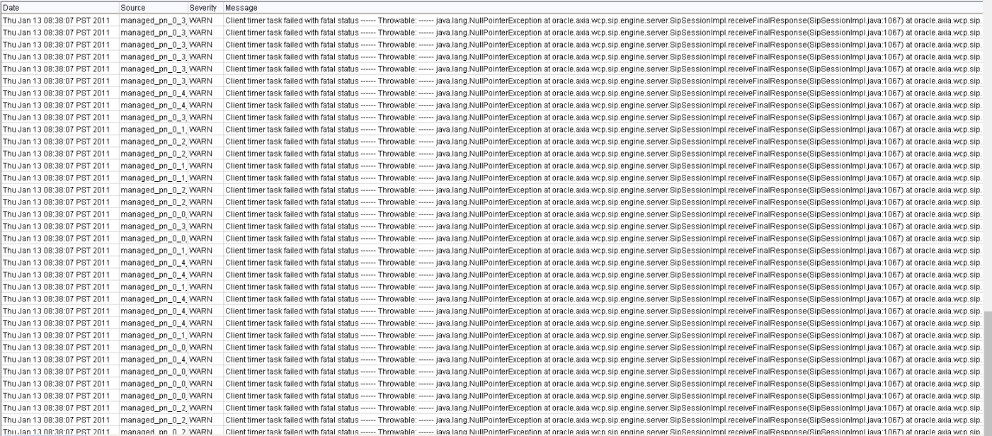
Logs – fine grained reports
Log event (typically when something happens):
resource
timestamp
log level
message | error code
body (input, action, result, …)
when log event is associated with a job | request | transaction:
[trace] context
tags | attributes
Logs provide drill down details for trace-span
Consolidated logs – from across application landscape – are powerful analysis tool
timestamp is crucial to sort and correlate
platform & infra
logs

Slide 33

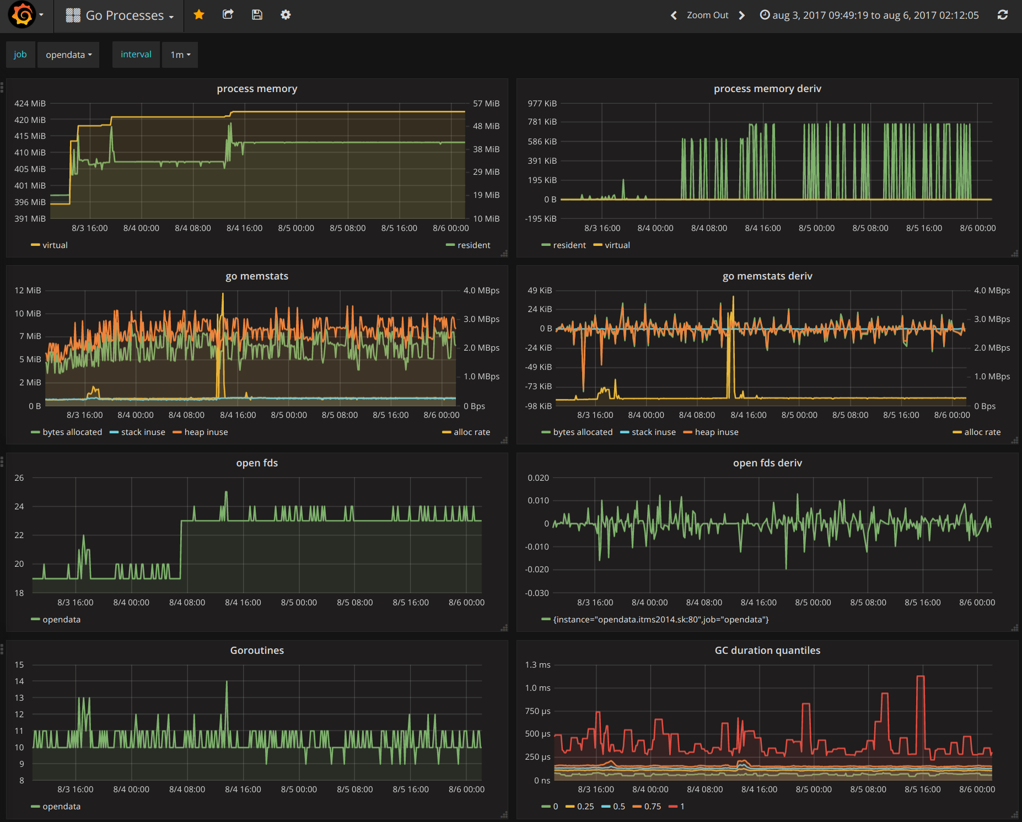
Metrics – periodic mini status reports
Timestamped measurements, typically numeric values
that can be aggregated and “graphed”
Sometimes pushed, often polled/scraped
Examples: CPU utilization, disk free space, number of IOPS, number of Pod instances, number of in-flight requests, maximum response time, memory usage Or: Total order amount today, number of visitors in last 5 minutes, number of records processed by integration X
Note:
writing a measurement as log event is another way of recording a metric
metrics are usually not associated with specific requests | transaction | job
platform & infra
metrics

Slide 34

OpenTelemetry
Cross industry standard for collection of Telemetry
format of MLT (metrics, logs, traces)
communication protocol
telemetry collector / preprocessor / exporter
libraries for instrumenting applications and platform components to produce telemetry
All tools for monitoring, analyzing, visualizing telemetry support OpenTelemetry

Slide 35

Events – telemetry context for analyzing and predicting
Black Friday
Horizontal Scale Out (double capacity for Service X)
Rollout/activation of new version of Service Y
Start of batch job Z
Snowstorm in the München area
Upgrade of Library P
New certificate for Component Q
Purged 2 TB of data from Time Series Database R
Outage in Azure Data Center (Frankfurt region)
Semi Final in World Cup Football between A and B
New engineer joined the DevOps team
Recovery test on database C
Ticket logged regarding poor performance
Expiry of Certificate K

Slide 36

Collect, Correlate, Interpret, Alert
Create the overall picture
Compose end-to-end trace from correlated trace spans
Associate logs with traces
Annotate telemetry using events and other context
Identify anomalous traces
Aggregate over traces, components, trace context
find bottlenecks, identify trends and patterns
Locate errors and exceptions in logging
Find metrics (trends, exceptions) of interest
Find what’s missing – unexpected unevents
Automate: apply alert rules to collected telemetry data
trigger alert
send notifications | create ticket | start automated workflow

Slide 37





Ops Obs is a veritable BI challenge
Instrumentation & Configuration determines telemetry
Traces, Log entries, Metrics, Context Events
Service
API
WebApp
Telemetry Lake
Function
Integration
Job
platform
infra

Slide 38
The Ideal Dashboard …

Slide 39

The Ideal Dashboard …
Dashboard
Now
Past & Future

Slide 40
The Ideal Dashboard …
Dashboard - Now
Now
Past & Future
Alerts Notifications Actions
Heartbeat – Proof of Health

Slide 41
The Ideal Dashboard …
Dashboard – Past & Future
Now
Past & Future
Trend & Pattern Charts Predictions Simulations / What-If explorations

Slide 42
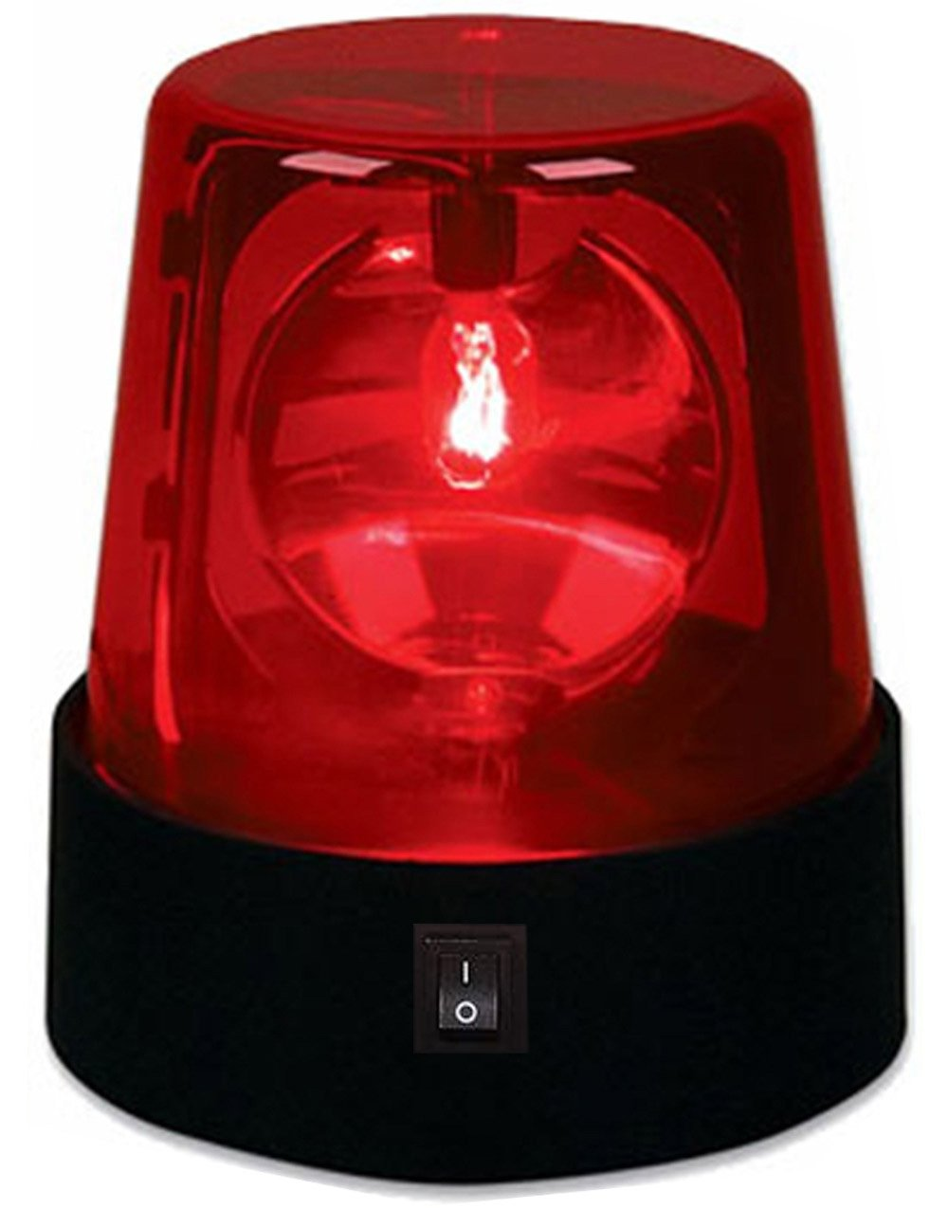
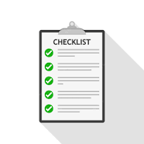

Act upon Alert
?
Need to know what to do when and how to do it then
what information is required? and how to get it?
what means to use? and where to find them?
which (elevated) access privileges are needed?
who to inform or consult?
what to do? (checklist, decision tree when to stop & escalate)
what to log and report?
how important is it

Slide 43
1202
Notes:
https://www.slideserve.com/ayala/se-3910-real-time-systems

Slide 44
1202

Slide 45
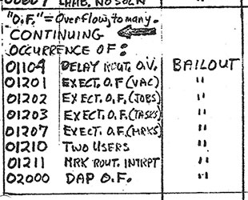




1202

Slide 46
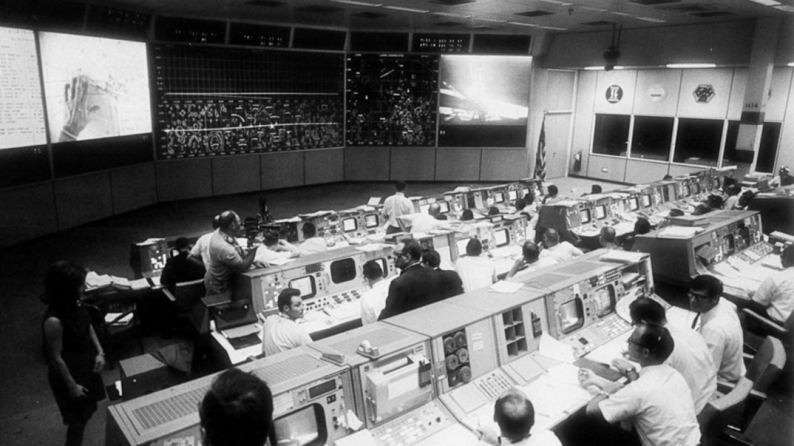
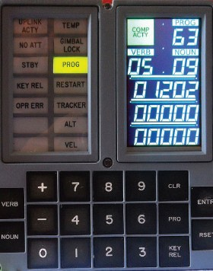


Slide 47
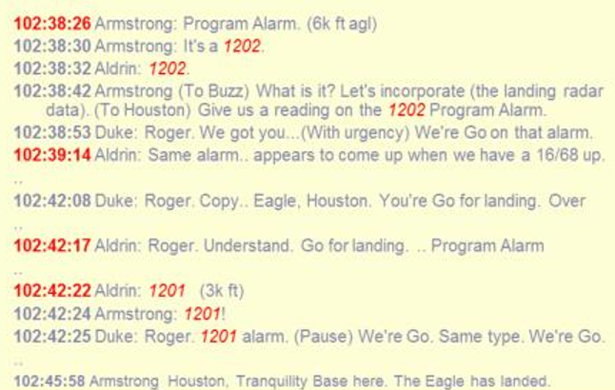






Slide 48

Means & Mandate to act – Application & Platform/Infra
Get detailed information
inspect systems, services, queues, files, requests, …
Reconfigure (and apply | test | revert)
Scale out (& in), up (& down)
Restart service | server
Resubmit request | event | job
Apply Patch
(Re)schedule job
Perform recovery
Provision & Update Infra (cloud resources)
Acquire (temporary) elevated privileges
Observe
Interpret
Act
Learn & Improve
Routine Management
Fire drills / Chao(p)s Testing
Report & Improve
Notes:
expired certificate
Product Owner cannot be reached
Wiki is down
Storage inaccessible
Critical vulnerability in library
DDOS attack detected
Ransomware alert
Data Corruption (human error)
failing DNS server
Azure availability zone is down
team tech lead falls ill
P1 bug in recent production release
Edge connectivity lost
Power outage

Slide 49

Operations Firedrills - Observing the Monkey
“fire drills” – in live systems
Testing Resilience of
systems & automated procedures
processes
people
By deliberately introducing errors in runtime [-like] environments
To test & prove & enhance measures
No internet, no wiki, no email, failed rollout, expired certificate/password, collapsing server, peak load, failing data center, …
Azure availability zone is down
Ransomware alert
Storage inaccessible
Data Corruption (human error)
expired certificate
team tech lead falls ill
Edge connectivity lost
Critical vulnerability in library
failing DNS server
Product Owner cannot be reached
P1 bug in recent production release
Power outage
DDOS attack detected
Wiki is down
Notes:
expired certificate
Product Owner cannot be reached
Wiki is down
Storage inaccessible
Critical vulnerability in library
DDOS attack detected
Ransomware alert
Data Corruption (human error)
failing DNS server
Azure availability zone is down
team tech lead falls ill
P1 bug in recent production release
Edge connectivity lost
Power outage

Slide 50

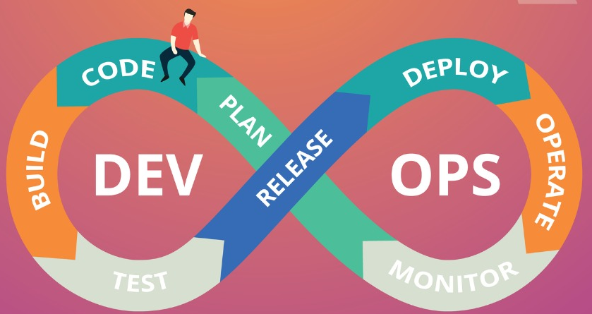
Improvements over time
Observe trends and patterns, incidents, time consuming activities
Explore What-If scenarios – based on business ambitions & real observations
Automate humanual activities
Calibrate platform/infra configuration – for example capacity/sizing
Refine job schedules – integration & operations as well as platform/infra-scale
for performance improvement and also for cost reduction
Fine-tune Tools and Procedures (checklists)
Refine instrumentation (what telemetry is available)
more, less, better
Improve telemetry collection & interpretation & visualization/publication
Improve checks & controls for success & failure
Decommission un(der)used resources

Slide 51
Summary
Integration Operations for successful data availability
Define success
Design & Build Observability & Operability
Information - to detect | analyze | decide
Instructions – to handle
Means – to act
Test of Operations
Shift Left – “Ops by Design”
Development
DevOps
Operations
Application
Platform

